Slide 1

Digital Portfolio
STUDENT NAME: KANIMOZHI V
REGISTER NO AND NMID:222407892 & autunm1455ds242732
DEPARTMENT: BSC.CS WITH DS
COLLEGE:TAGORE COLLEGE OF ARTS AND SCIENCE & UNIVERSITY OF MADRAS

Slide 2

PROJECT TITLE
Blockchain
Artificial Intelligence
Internet of Things (IoT)
Augmented Reality & Virtual Reality
5G Connectivity
Edge Computing Quantum Computing

Slide 3


AGENDA
Problem Statement
Project Overview
End Users
Tools and Technologies
Portfolio design and Layout
Features and Functionality
Results and Screenshots
Conclusion
Git hub Link
3/21/2024 Annual Review

Slide 4

PROBLEM STATEMENT
In the modern digital landscape, conventional resumes fall short in capturing a person's full range of abilities, accomplishments, and creativity. With increasing competition, students and professionals often struggle to build a compelling online identity. Most lack a cohesive platform to display their talents, innovations, and growth. A digital portfolio serves as a dynamic and user-friendly solution, enabling individuals to effectively showcase their expertise, projects, and personal journey.

Slide 5
PROJECT OVERVIEW
This project explores the dynamic evolution and multifaceted impact of modern technology across industries and society. It delves into transformative innovations such as Artificial Intelligence, Blockchain, IoT, and Quantum Computing, examining how they reshape communication, automation, and decision-making. Alongside these advancements, the project addresses pressing challenges including data privacy, ethical concerns, digital inequality, and environmental sustainability. Through research, case studies, and analysis, the goal is to understand not only how technology drives progress but also how it must be governed responsibly to ensure inclusive and secure development for the future.
My portfolio contains(Home, About , skills, contact)
Main idea : Learning to improve Skill and portfolio

Slide 6

WHO ARE THE END USERS ?
General consumers : To( use digital products and Services for daily needs).
Students and Educators : For (learning, teaching and academic project)
Government Agencies : To (deliver public services and maintain digital government).
Organizations and Enterprises : To(manage operations, data, and client services).
Developers and engineers : To (build, test, and deploy technological solutions).
Business professionals : To (increase productivity, manage tasks, and enhance communication).

Slide 7
TOOLS AND TECHNIQUES
HTML : Structure(pages, sections).
CSS : Styling(colors, layouts , responsiveness).
JAVASCRIPT : interactivity( navigation menu, animations, form validation).
Mention code editor(VS code) or CODEPEN and hosting platform
(GitHub Pages).

Slide 8

PORTFOLIO DESIGN AND LAYOUT
1. Home / About Me
This is the introduction section where you present yourself to the visitor. It usually contains your name, profession (like "Web Developer" or "Software Engineer"), and a short tagline that reflects your passion. The "About Me" part can include your background, education, and career goals. You should keep it clear and professional while also showing some personality. A good "About Me" tells who you are, what you do, and what makes you unique. 2. Skills
In this section, you display the technical and soft skills you possess. Technical skills may include programming languages (Java, Python, C++), frameworks (React, Django), tools (Git, Docker), and other relevant technologies. You can also highlight soft skills like problem-solving, teamwork, and communication. Using progress bars, skill charts, or badges makes this section more attractive and easy to understand.
8

Slide 9
PORTFOLIO DESIGN AND LAYOUT
3. Contact
The contact section provides ways for people to reach out to you. It usually includes your email address, phone number, and links to professional profiles like LinkedIn or GitHub. You can also add a simple contact form so visitors can send you a direct message from your portfolio. A good contact section shows that you are approachable and open to opportunities.
4. Responsive Layout (Mobile + Desktop View)
A portfolio should look good on all devices — desktops, laptops, tablets, and mobiles. A responsive layout ensures that the design automatically adjusts to the screen size, providing a smooth user experience. This includes flexible grids, images that resize, and navigation menus that adapt to smaller screens. A responsive portfolio makes you look professional and shows that you understand modern web design practices.

Slide 10

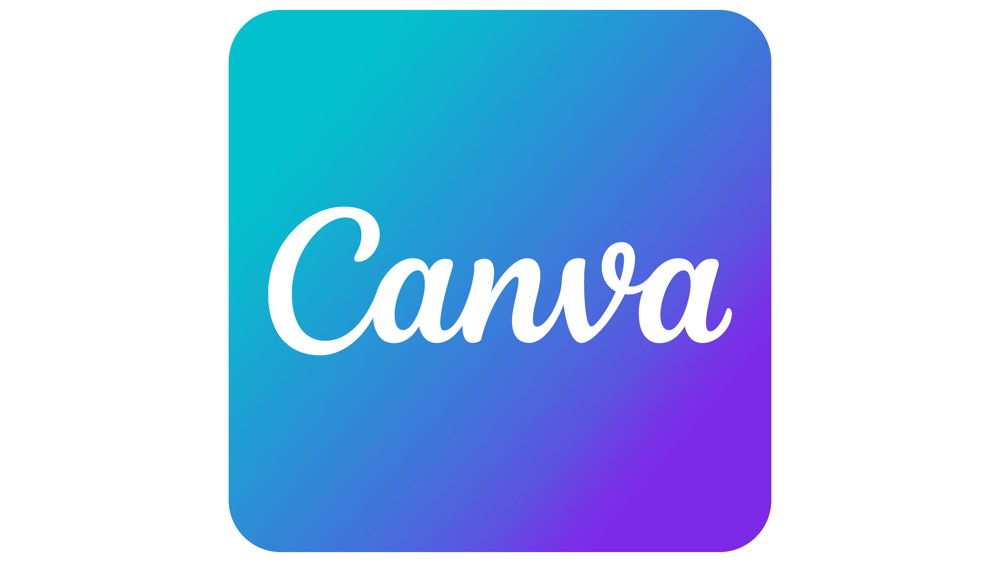

PORTFOLIO DESIGN AND LAYOUT
A clean and simple portfolio PowerPoint should include an intro slide with your name and title, followed by sections like About Me, Skills, Projects, Certifications, and Contact Info. Use visuals, icons, and short descriptions to keep it engaging. You can create and present your portfolio using platforms like Microsoft PowerPoint, Google Slides, or Canva. For sharing online or building a digital version, platforms like Be hance, GitHub (for tech work), Notion, or Adobe Portfolio are great choices.

Slide 11
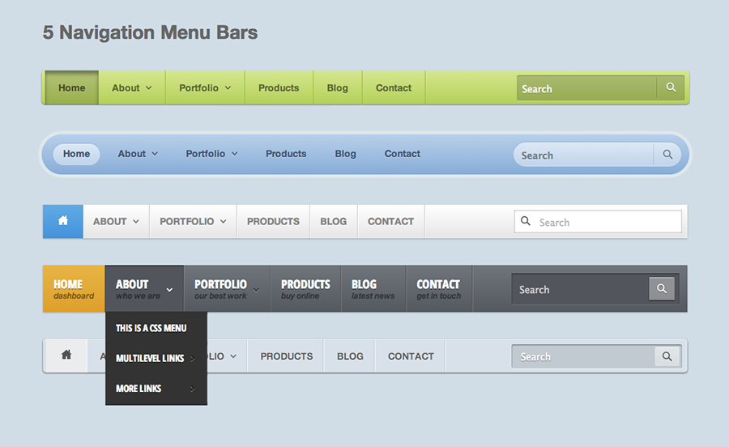
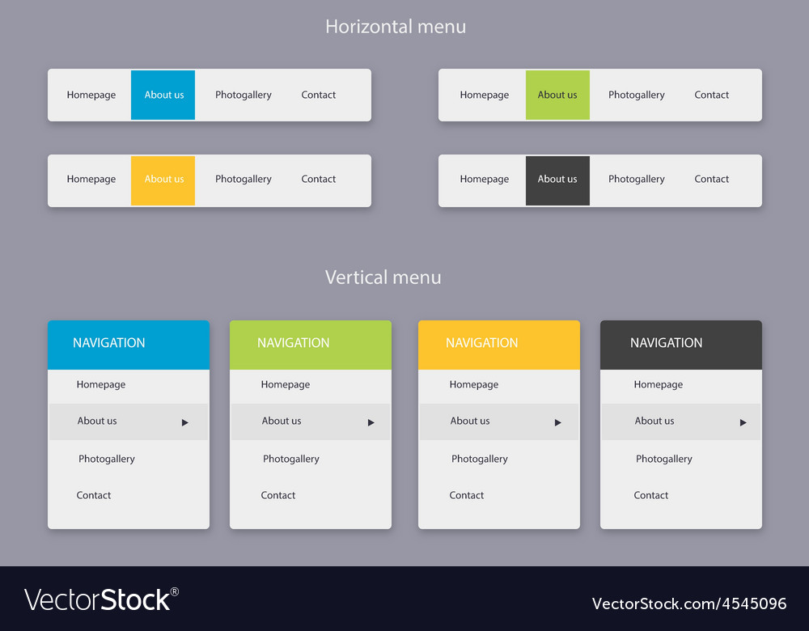
FEATURES AND FUNCTIONALITY
1. Glide Nav – Smooth Navigation Bar
A navigation bar is the backbone of any portfolio website. It allows visitors to easily jump between different sections, such as About Me, Projects, Skills, and Contact. A smooth scrolling effect makes this transition feel seamless and modern, giving users a pleasant browsing experience. A sticky or fixed navigation bar ensures that links are always accessible, even when the visitor scrolls down the page. This feature not only improves usability but also reflects professionalism in your portfolio.

Slide 12

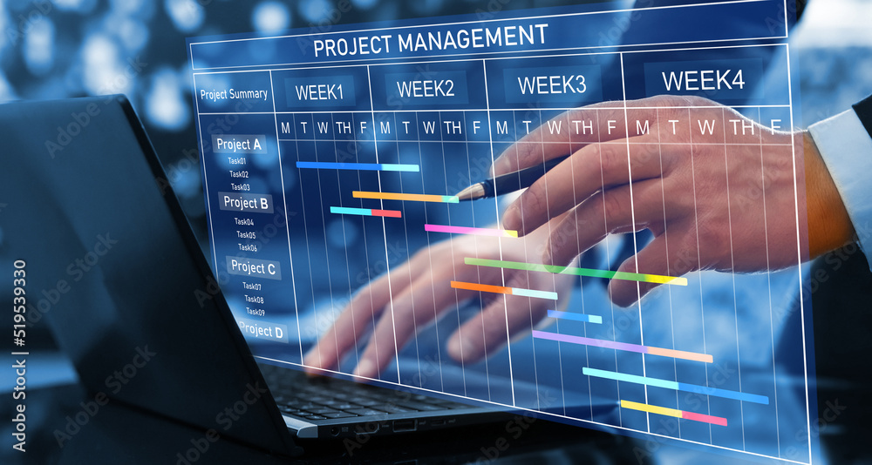
FEATURES AND FUNCTIONALITY
2. Project Spotlight – Showcase with Images and Details
The projects section is one of the most important parts of your portfolio because it highlights your practical work and skills. Each project can be displayed using a visually appealing card that contains an image, title, short description, technologies used, and links to live demos or source code. Including images makes your work more attractive and helps visitors quickly understand what the project is about. A clear and organized project showcase convinces recruiters and clients about your hands-on abilities.

Slide 13


FEATURES AND FUNCTIONALITY
3. Micro-Interactions – Hover Effects and Animations
Adding interactive elements like hover effects and animations makes your portfolio stand out. Subtle effects, such as buttons changing color when hovered over or cards lifting slightly when clicked, create a sense of responsiveness and polish. Smooth animations when scrolling down the page also keep users engaged. These micro-interactions give your portfolio a professional and modern feel without overwhelming the user with too many flashy effects.

Slide 14
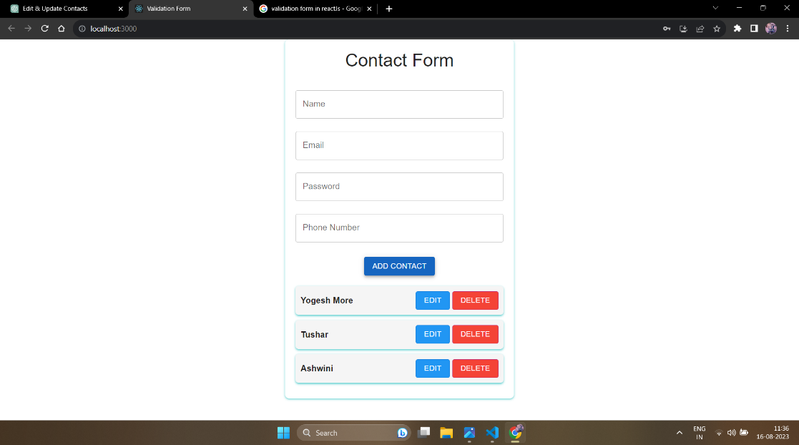
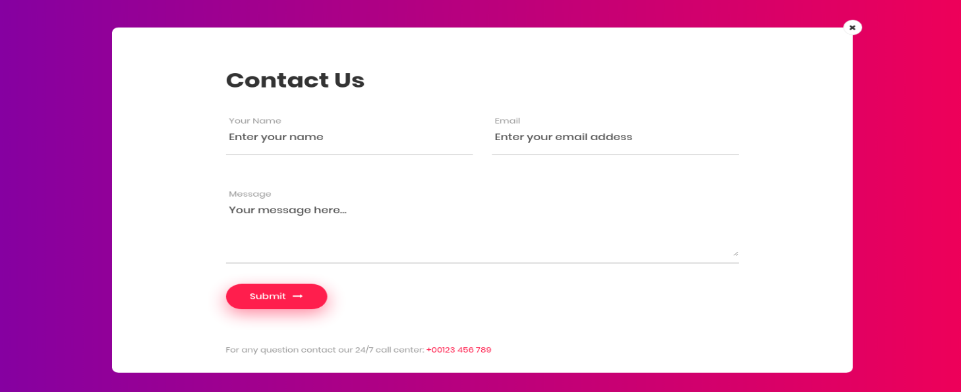
FEATURES AND FUNCTIONALITY
4. Safe Connect – Contact Form with Validation
A contact form is an essential feature that allows people to reach out to you directly. A good form should include fields for name, email, and message. Input validation ensures that users provide correct details before submission, preventing errors like empty fields or invalid email addresses. This shows that you care about user experience and data accuracy. A well-designed contact form makes it easy for recruiters, employers, or clients to get in touch with you for potential opportunities.

Slide 15
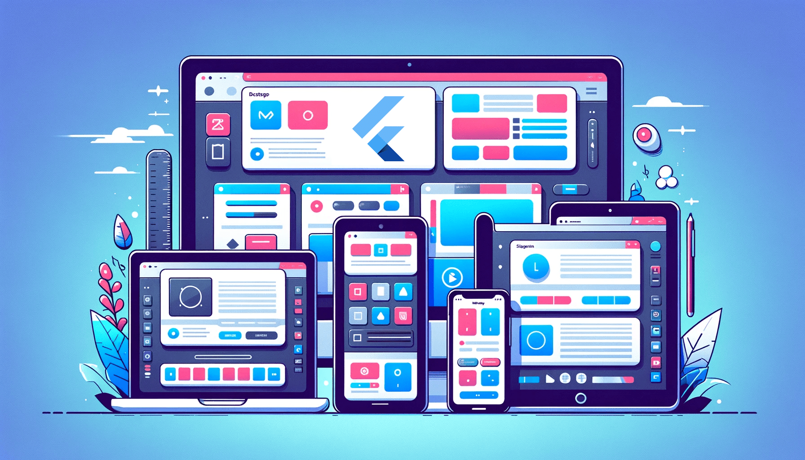
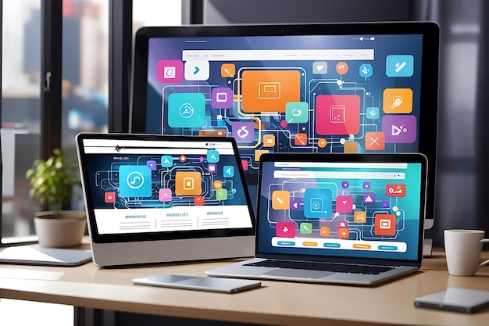
FEATURES AND FUNCTIONALITY
5. Any Screen Layout – Responsive Design for All Devices
In today’s world, people use multiple devices like mobiles, tablets, and desktops to browse the internet. A responsive design ensures that your portfolio adapts to any screen size while maintaining readability and aesthetics. Using flexible grids, CSS media queries, and fluid layouts makes your portfolio user-friendly across devices. A responsive portfolio not only improves accessibility but also demonstrates your ability as a developer to follow modern web design practices.

Slide 16
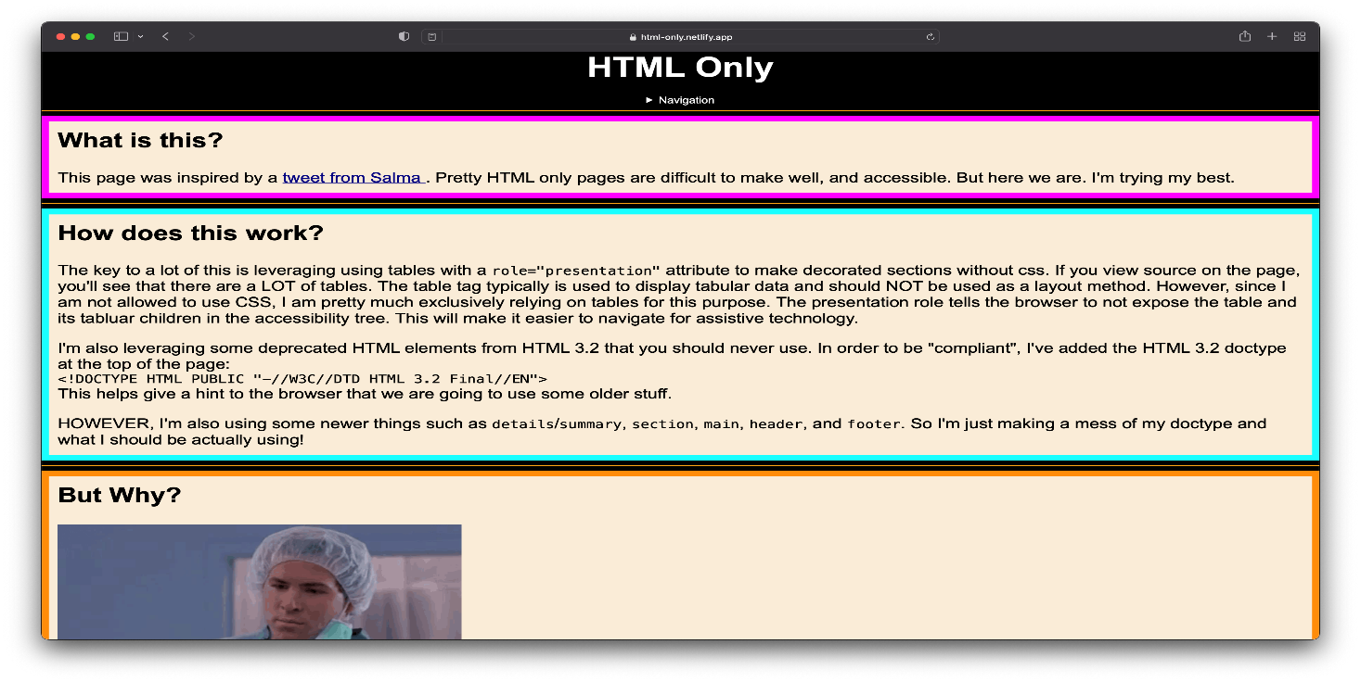
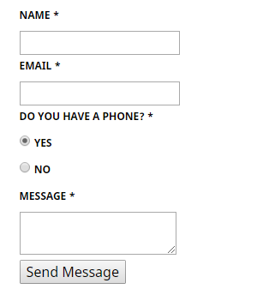
RESULTS AND SCREENSHOTS
HTML (Structure)
HTML (Hyper Text Markup Language) is the backbone of any website. It provides the basic structure and content of the webpage. For example, in your portfolio screenshot, HTML defines the navigation bar with links (About, Projects, Skills, Contact), the heading “Creative Coder”, and the sections like About Me and Projects. Without HTML, there would be no text, headings, or buttons — only a blank page. Think of HTML as the skeleton of a website, holding everything in place.
3/21/2024 Annual Review
16

Slide 17
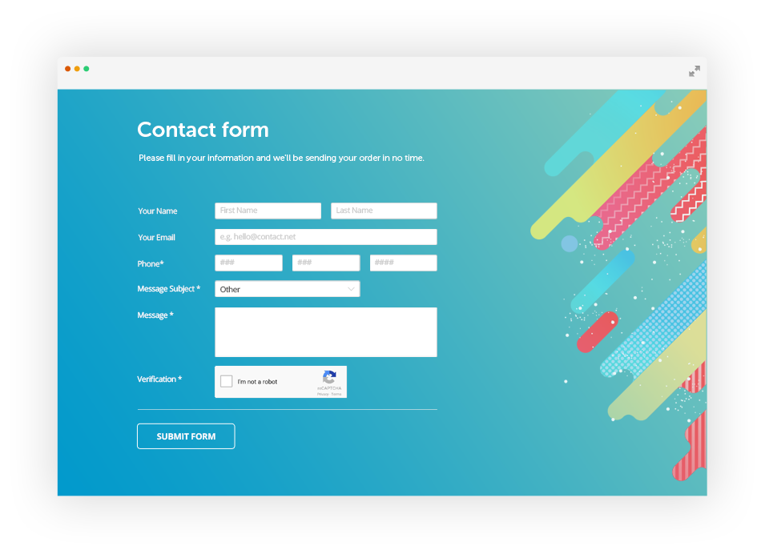
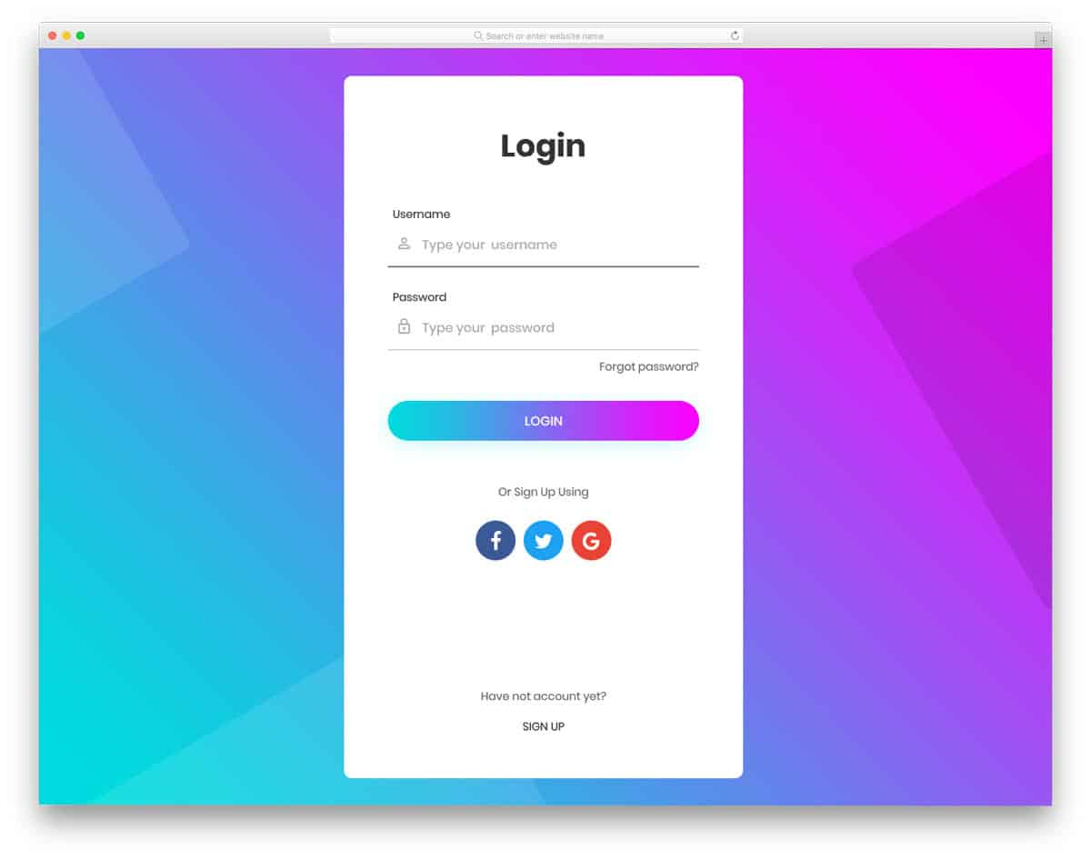
RESULTS AND SCREENSHOTS
CSS (Style and Design)
CSS (Cascading Style Sheets) is used to make the website visually appealing. It controls colors, fonts, layouts, spacing, and responsiveness. In your portfolio screenshot, CSS is what makes the navigation bar blue, aligns the links neatly to the right, and applies spacing between the sections. It also helps the website look good on different devices (desktop or mobile). If HTML is the skeleton, CSS is the skin, clothes, and overall appearance of the website.

Slide 18
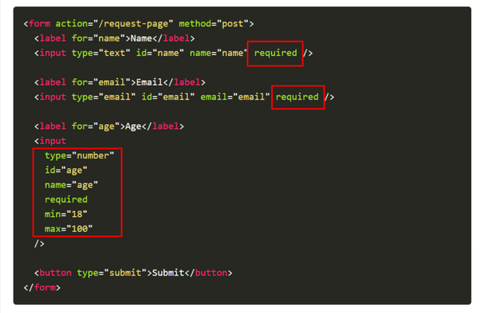
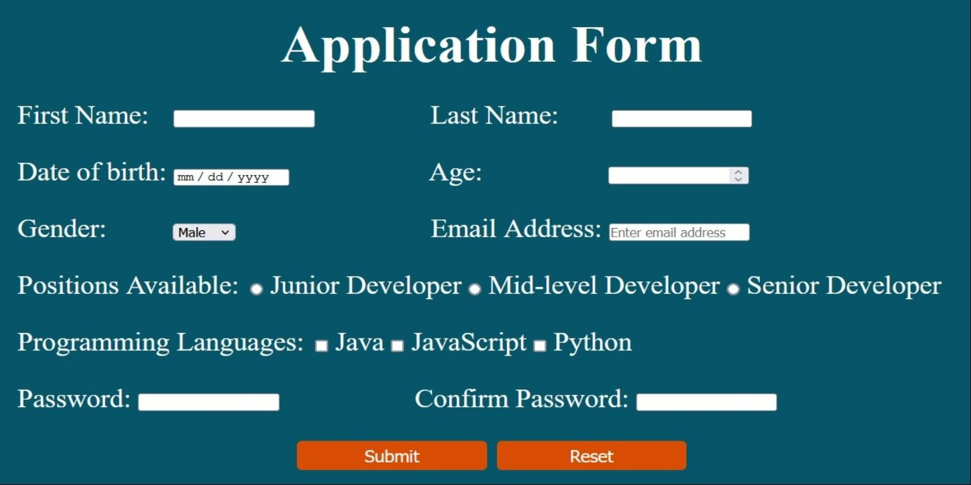
RESULTS AND SCREENSHOTS
JavaScript (Interactivity and Functionality)
JavaScript brings the website to life by adding interactivity and dynamic features. In your portfolio, JavaScript could be used to enable smooth scrolling when clicking navigation links, form validation in the Contact section, or even a dark/light mode toggle button (like the switch icon in your screenshot). It can also create animations, hover effects, and interactive elements that make the site feel modern and engaging. If HTML is the skeleton and CSS is the skin, JavaScript is the brain and muscles that allow the website to move and respond to user actions.

Slide 19



CONCLUSION
Highlights of Technology
Innovative and user-friendly design with modern technology.
Efficient performance ensuring smooth user experience.
Provides real-world solutions to common challenges.
Scalable and adaptable for future requirements.
Focuses on accessibility and digital empowerment.
Encourages innovation, creativity, and learning.

Slide 20

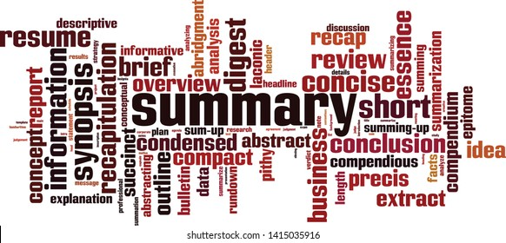
CONCLUSION
Final Summary:
AI is designed to empower users with innovative technology solutions that simplify complex tasks and enhance productivity. The project integrates modern tools, user-friendly design, and efficient performance to create a reliable platform that addresses real-world challenges. By combining creativity and technology, Tech provides a seamless experience while ensuring adaptability for future growth.

Slide 21
CONCLUSION
Benefits to Society:
Bridging the Digital Gap: AI makes technology more accessible and easier to use for people from different backgrounds.
Improving Efficiency: It helps individuals and businesses save time and resources by streamlining processes.
Encouraging Innovation: By fostering digital literacy and creativity, Tech inspires the next generation to explore technology.
Sustainable Impact: Promotes eco-friendly digital solutions, reducing dependency on paper-based systems.
Community Growth: Supports education, collaboration, and skill-building for a better, tech-driven society.

Slide 22


CONCLUSION
GIT HUB LINK : PORTFOLIO

